Slide 1
Concepts of Biology Biol 111 Minot State University
Lecture, MWF 12:00-12:50 pm
Cyril Moore Science Center, Room 16
Lab, Tuesdays/Thursdays
Swain Hall, Room 304

Slide 2
Lecture 9 Febrary 2, 2018
Exam 1 will be returned to you in your individual lab sections. Let’s go over the exam now—You should jot down the correct answers for reference when you get your exam returned.
Notes related to exams will also be helpful for the final exam.

Slide 3
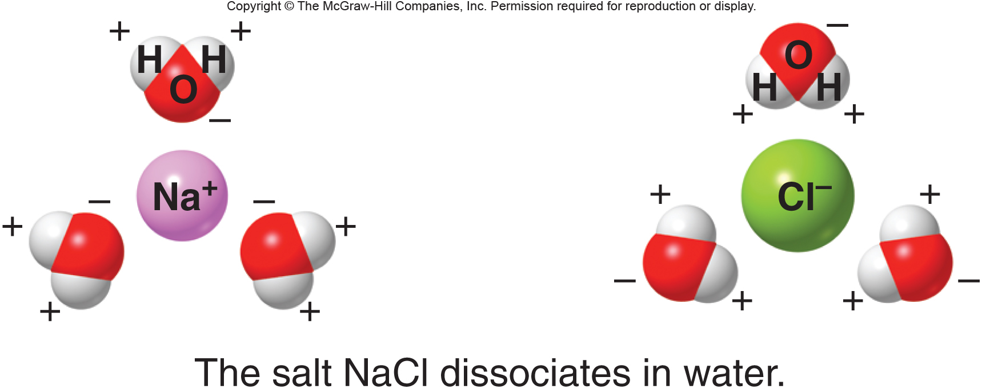
Last question/ This is in lecture 6, was drawn on the white board when we discussed water as a solvent in cells

Slide 4
Where were we?
The 4 primary large organic molecule types in cells.
Carbohydrates
Lipids
Proteins
Nucleic Acids

Slide 5
Different proteins have different functions based on their overall folded shape.
4 levels of proteins structure
Primary (amino acid sequence)
Secondary (helix or sheet)
Tertiary
Proteins can fibrous (primarily helix OR primarily sheet)
Proteins can be combinations of helix and sheet
Quaternary

Slide 6
Proteins assume 2 basic overall shapes:
Long, extended, rod-like= fibrous. Fibrous proteins are usually mostly α helix. Proteins that provide strength and stretch are fibrous.
Examples:
Keratin in hair, fingernails, horns and scales.
Collagen in skin, tendons, ligaments, cartilage

Slide 7
2. Globular---globular proteins are usually a mixture of α helix and β sheet. The fold into a rounded, irregular, globby shape.
Most enzymes are globular. Hemoglobin is globular

Slide 8
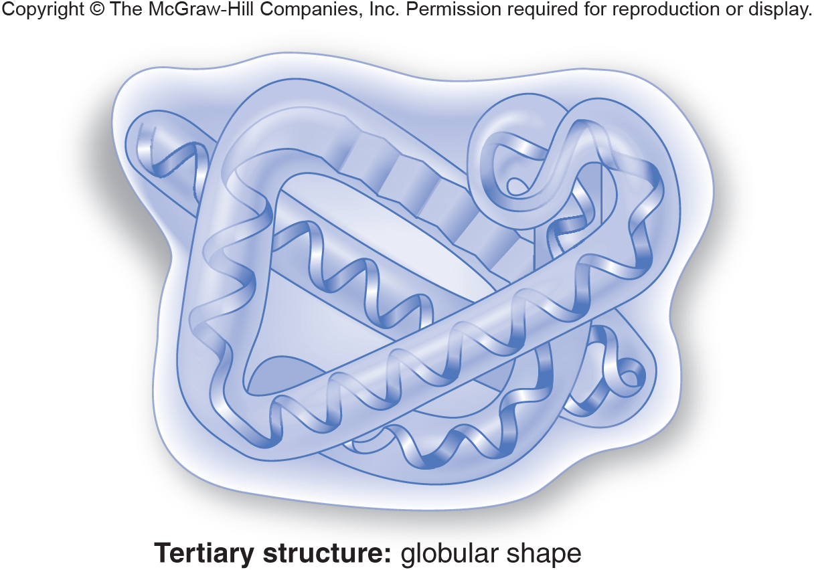
Fig. 3.19c

Slide 9
Remember---protein shape is not random or variable---a given amino acid sequence will fold in the same way every time. Even globular proteins make the same “glob” every time!
Even so…proteins can be unfolded if conditions change…high temperature, changes in pH or specific chemicals can unfold or denature proteins.

Slide 10
Recall homeostasis? Keeping living conditions steady and stable?
The primary reason for homeostasis is to keep proteins folded properly!!!

Slide 11
Finally---many cellular proteins are actually made of more than one protein subunit. The interactions between individual protein units which gives the protein its final shape is called quaternary structure.
Hemoglobin is actually a 4 protein-protein.

Slide 12
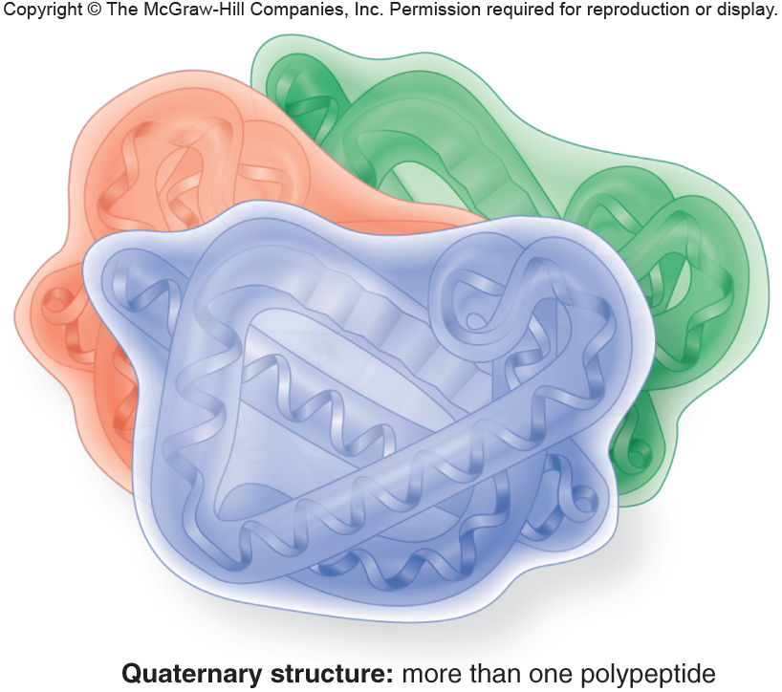
Fig. 3.19d

Slide 13
The 4 primary large organic molecule types in cells.
Carbohydrates
Lipids
Proteins
Nucleic Acids

Slide 14
Nucleic acids
The DNA and RNA in our cells are nucleic acids.
DNA is the chemical code for all the proteins an organism makes.
RNA is an intermediate between used in the making of proteins.

Slide 15
The specific region in a DNA molecule that encodes a protein is called a gene.

Slide 16
The flow of information
Proteins are made in a 2-step process.
DNA is transcribed into RNA
RNA is translated into protein
Ultimately the sequence of the DNA dictates the sequence of the RNA and then the sequence of amino acids in the protein.

Slide 18
Like all the molecules discussed thus far, DNA and RNA are polymers of smaller subunits.
The subunits are called nucleotides.
What kind of functional groups do you see on nucleotides?

Slide 19
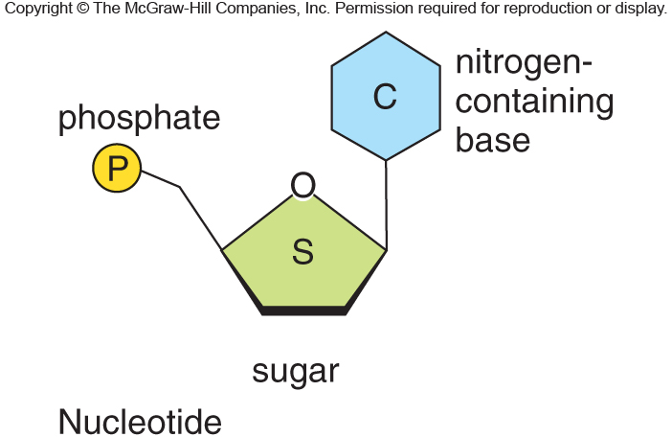
Fig. 3.20a

Slide 20
There are 4 different nucleotides in DNA. The only difference in them is the nitrogen-containing base.
DNA bases---Adenine, Guanine, Cytosine, Thymine
The nucleotides bond to each other to form a DNA strand.
2 DNA strands bond to each other via interactions between the Nitrogen-containing bases. When base-pairs form a helix is made.

Slide 21
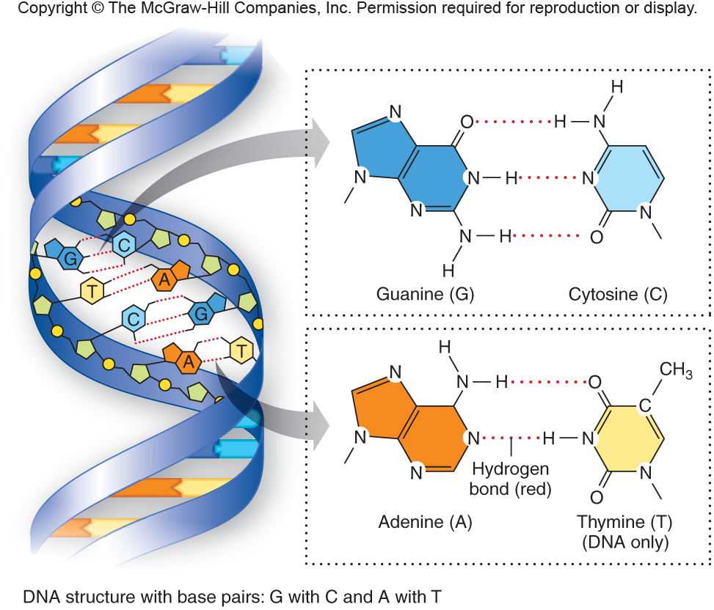

Slide 22
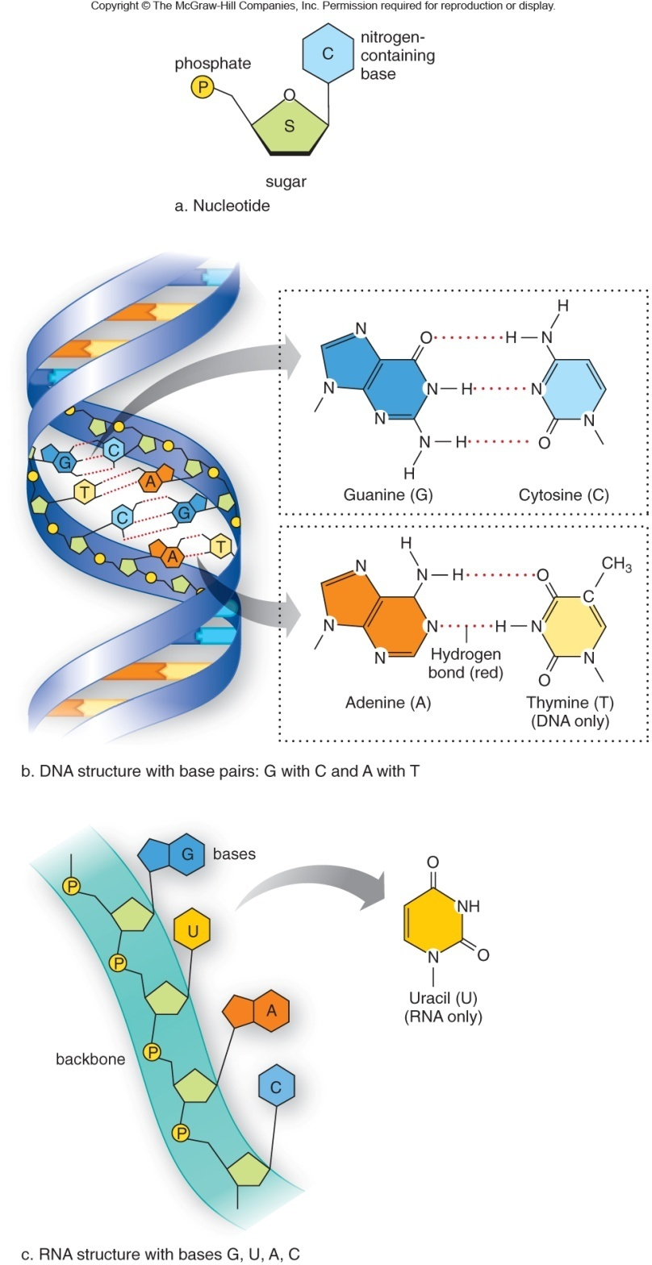

Slide 23
The sequence of nucleotides is different in different genes.
The sequence of nucleotides determines the sequence of amino acids in the protein.
Each unique gene makes a different protein (which folds uniquely to give it a different function)
Humans make about 20-30,000 different proteins.

Slide 24
A minor change in DNA can have a major change in a protein.
The very first example of this came from a disease known as sickle cell anemia.
A single letter change in a gene makes a single amino acid change in a protein making up hemoglobin

Slide 25
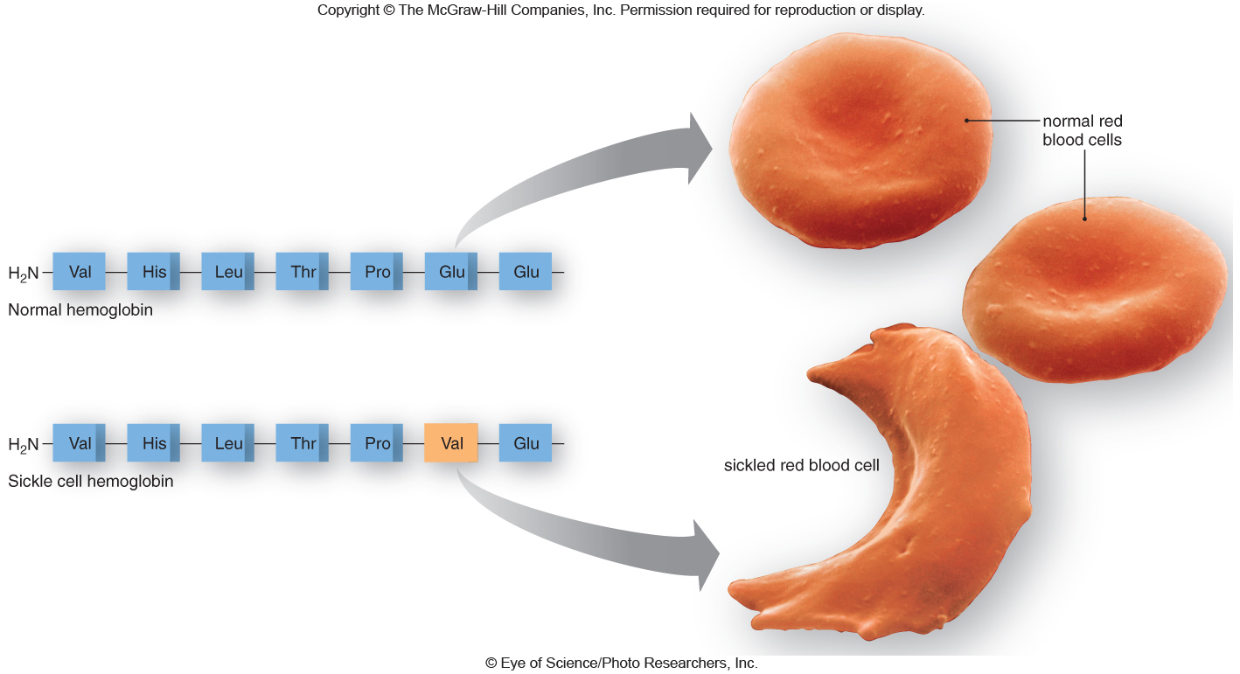
Fig. 3.21

Slide 26
The single change in the hemoglobin protein causes the red blood cell to change shape (sickle) and it is unable to properly carry oxygen. Tissues become deprived of oxygen and red blood cells clog up blood vessels.
This is the first disease shown to have a genetic basis!

Slide 27
Fun Fact (really not so fun…)
Sickel cell anemia/disease is serious. It is painful, and it affects multiple aspects of health. It can be fatal. It may affect reproduction because it is most often fatal in children.
https://www.mayoclinic.org/diseases-conditions/sickle-cell-anemia/symptoms-causes/syc-20355876
You must inherit a defective gene from both mother and father to have the sickle cell disease.
If you inherit one defective gene and one normal gene you show less severe symptoms called sickle cell trait.

Slide 28
Natural selection?
Why hasn’t natural selection reduced or eliminated sickle cell anemia?
Do you know anyone (including you) with the disease or trait? Is it common in any particular place or among people of certain ancestry?
BTW—over 2 million people in the US have the the disease or trait.

Slide 29
Regions of the world with the highest levels of sickle cell anemia/disease

Slide 30
There seems to be a regional selection FOR sickle cell anemia.
Is there an explanation? YES! As it turns out, having one abnormal SC gene actually makes it harder for you to contract MALARIA! (And sickle cell trait is not fatal)
Malaria is a terrible disease that kills more than 1 million people every year!

Slide 31
Where is malaria most common and why?

Slide 32
Do you see the connection?
Having one abnormal sickle cell gene makes you more likely to avoid malaria. Mosquitos carry malaria parasite and infect red blood cells with it. Sickled red blood cells are resistant to malaria parasite.
But natural selection for the abnormal gene means sickle cell disease can persist despite its sometimes fatal effects…

Slide 33
For Monday
Read posted link/article of the effects of climate change on oyster production. Chemistry matters in biology!
Read Chapter 4---All.
We begin cells---and you now have some experience with plant and animal cells from lab 3. ☺

